Slide 1
_{Using Database locking}
To control concurrent assignment of tasks following a long running query
Eugen Burianov
https://github.com/eugen8/ProjectsAndHighlights/tree/master/LockingDbConcurrentUsers

Slide 2
Problem
Concurrent request assignment of highest priority loans for one task from a list
The query checking the loans can run up to 30 seconds
Only one loan can be assigned to one task at any time
There is a high probability of concurrent access and duplicate assignment

Slide 3
Possible solutions
1) Synchronization at JVM level – more difficult in a clustered environment
synchronize(taskIdInt)
run the query & cache results
assign the loans
unlock the object
Other threads will assign from cache until expired
ON Clustered environments it is more difficult to sync threads across nodes
2) Use of database locking mechanism

Slide 4
Solution (part 1)
Record request for work
work_requested [requesting user id, task id, # of requested loans, # of actually assigned loans]
Run SELECT t.* from task t where t.task_id=:taskId for update skip locked
If rows available proceed with query, otherwise return busy flag and come back later
When list of loans available from heavy query – assign work to ALL users in work_requested with req>0 and assigned=0 and task_id=x

Slide 5
Solution (part 2)
Backend returns to the user 1 with assigned loans
User 2 browser that received busy flag will request retryWork in a few seconds for a couple of times.
If work_requested for the user and task is complete (i.e. req=1, assign=1 or req=0, assign=0) return work items (from work table)
User 2 will stop seeing loading message and will see the work assignment result and the loans.

Slide 6
Other interesting aspects
Disposition: Complete, Return to queue, Return in 48 hours, Final. Recorded with work[disposition_tmstp, available_tmstp]
Building the heavy query from user selected criteria to a query persisted in the database.

Slide 7
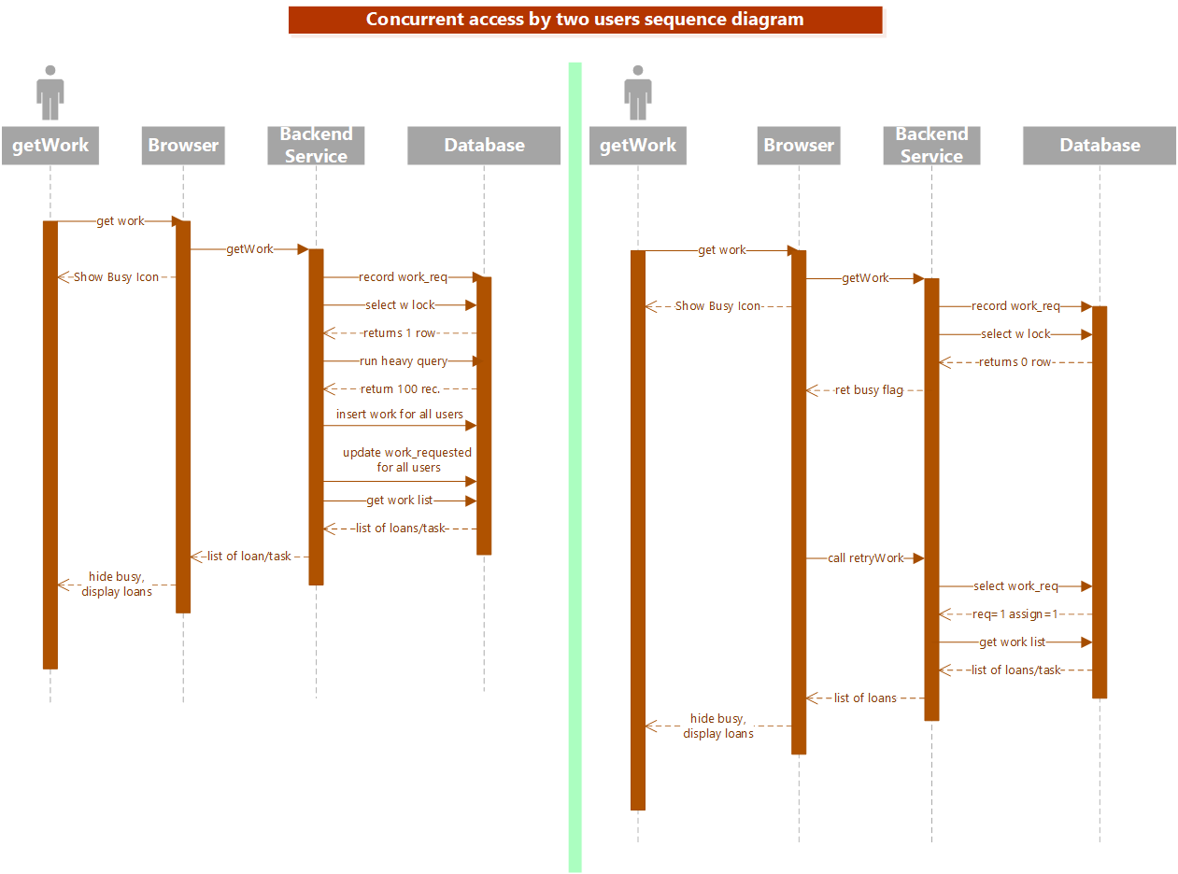

Slide 8
Potential improvement
Heavyweight query was still a problem. Some improvement there could help, e.g. a longer lived cache of results from the heavy query

